Slide 1

Crystring: A Token-Based Representation for Crystal Structures in Machine Learning
Qihan Fu
3/13/2025

Slide 2
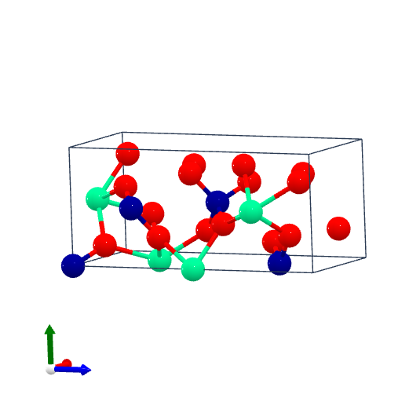
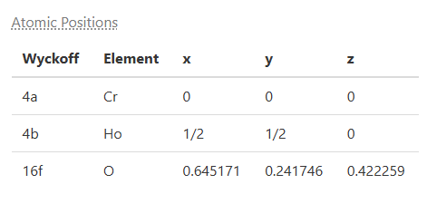


Crystring Representation
A Bidirectional Token-Based Representation for Crystal Structures
HoCrO₄
mp-19055
representation: I 41/a 1 1 Ho 4b 0.000 0.000 0.000 Cr 4a 0.000 0.000 0.000 O 16f 0.645 0.242 0.422
Notes:
This slide introduces Crystring, python package to generate bidirectional token-based representations for crystal structures,
Here is an example of HoCrO₄ (mp-19055). Crystring efficiently encodes crystallographic data by leveraging space group symmetry and Wyckoff positions, and then with this representation it can be converted back to crystal structure in ASE Atoms type
where the first four characters denote the space group name, and each subsequent five-character set encodes Wyckoff letter, multiplicity, element type, and XYZ values.
Wyckoff positions within the same set have the same symmetry level
significantly reducing data redundancy

Slide 3
Tokenization and Embedding Representation
Representation: I 41/a 1 1 Ho 4b 0.000 0.000 0.000 Cr 4a 0.000 0.000 0.000 O 16f 0.645 0.242 0.422
Tokens | START | I | 41/a | 1 | 1 | Ho | 4b | 0 | 0 | 0 | 0 | 0 | 0 | 0 | 0 | 0 | … | END
Vector | 12 | 30 | 137 | 16 | 16 | 106 | 34 | 1 | 1 | 1 | 1 | 1 | 1 | 1 | 1 | 1 | … | 13
 | X11 | X12 | X13 | X14 | X15
 | X21 | X22 | X23 | X24 | X25
 | X31 | X32 | X33 | X34 | X35
 | X41 | X42 | X43 | X44 | X45
 | X51 | X52 | X53 | X54 | X55
 | X61 | X62 | X63 | X64 | X65
 | X71 | X72 | X73 | X74 | X75
 | X81 | X82 | X83 | X84 | X85
 | X91 | X92 | X93 | X94 | X95
Embedding:
shape: [Max length, 1] to [Max length, embedding size]
Notes:
This slide explains the tokenization and embedding process for Crystring representations
Representation like a sentence can split into multi tokens or words. I also create a dictionary, unlike real word, instead of save meaning for each other, it save a value corresponding to each tokens.
Then is the embedding part for each token or value, I embed to a vector store potential relations with other tokens, these values will change and get improve while the LLM train and learn
Thus for each structure, we have 1d vector then embedding to 2d matrix

Slide 4
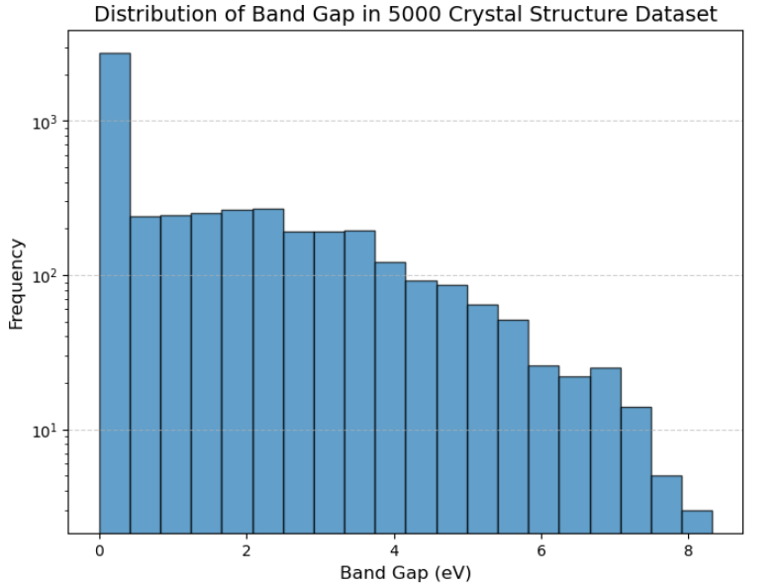
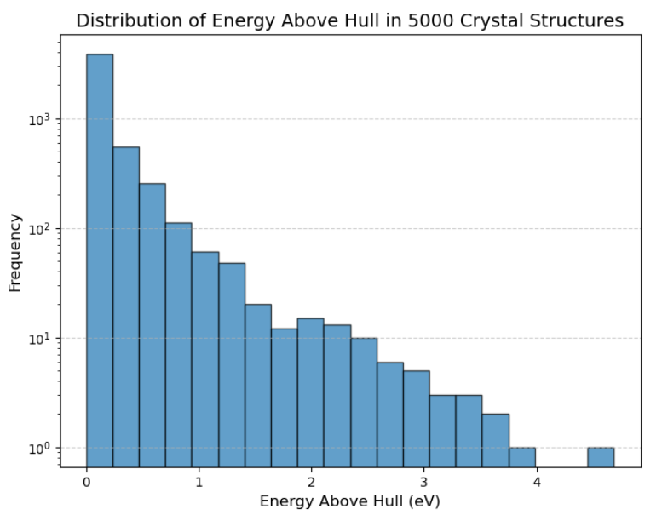
Token Based LSTM model
Lattice Parameters
A single regression model for all six lattice parameters.
Separate regression models based on different lattice types.
Band Gap
Classification: Determines if a material is a conductor or not.
Regression: Predicts the band gap for non-conducting materials.
Energy Above Hull
Classification: Determines if a structure is stable or unstable.
Regression: Predicts the actual energy value for unstable structures.
Notes:
For this final project I set 3 targets,
Predict lattice parameter, future purpose is with any unseen crystal structure representation I can predict unit cell parameters and reconstruct the crystal structure, and then use some well researched graphic NN like cgcnn or align to predict properties
I also try to predict properties directly from Crystring representation (Band Gap and Energy above hull)
In my materials databases targets are not evenly distribute. More conductor can semiconductor and insulator. So, I made two steps prediction
Energy above the hull is selected as the target to determine stability, primarily for future material discovery purposes.

Slide 5
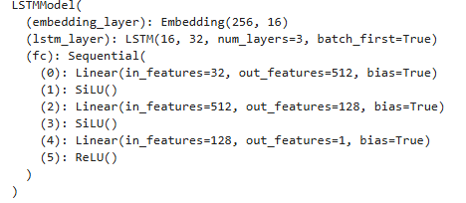
Token Based LSTM model
Regression:
Model Overview
Dataset:
5,000 crystal structures dataset
20,000 crystal structures dataset
Train test rate: 8:2
Hyperparameters:
Embedding size: 16
Hidden size: 32
FC layer output sizes: 512 and 128
Loss Function:
Regression: Mean Squared Error (MSE)Classification:
Binary Cross Entropy Loss (BCELoss)
Notes:
This slide presents a structure Token-Based LSTM Model for
he model utilizes an embedding layer to encode structural information, followed by an LSTM layer to capture sequential dependencies. A fully connected (FC) network refines the predictions
Use relu() at the end specify for bad gap regression to avoid negative value,
Use sigmoid for binary classification

Slide 6
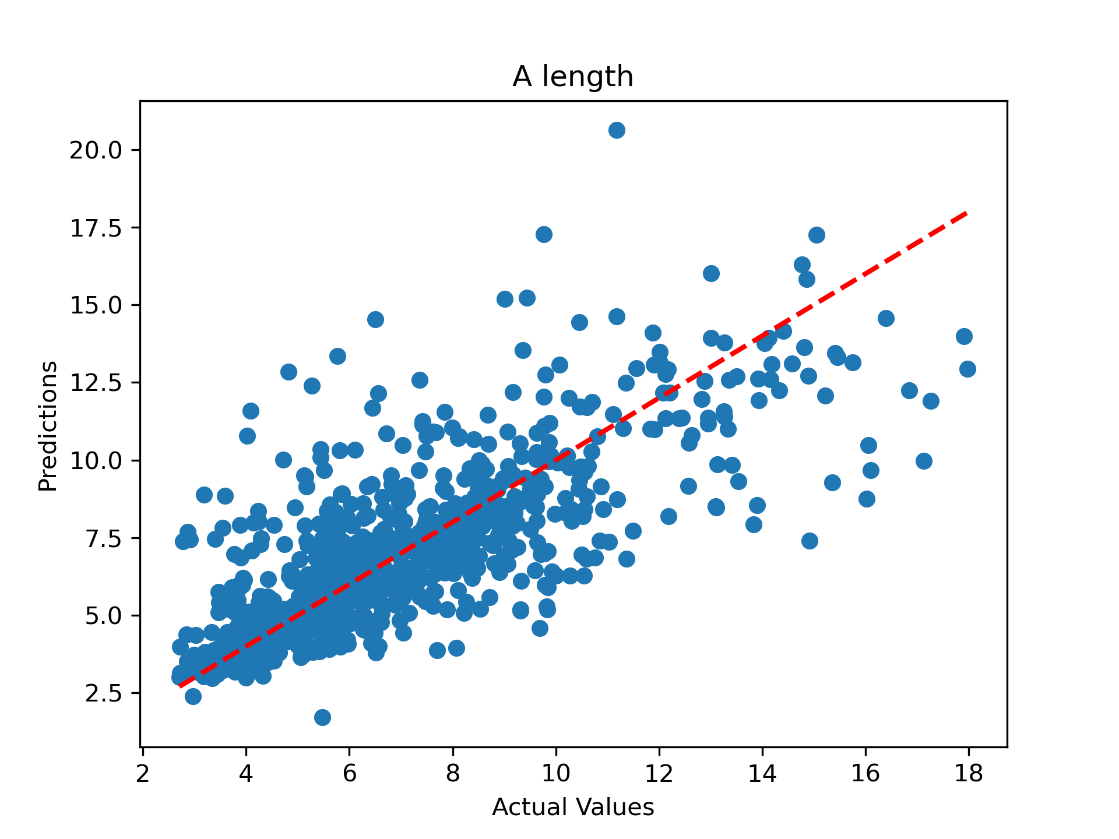
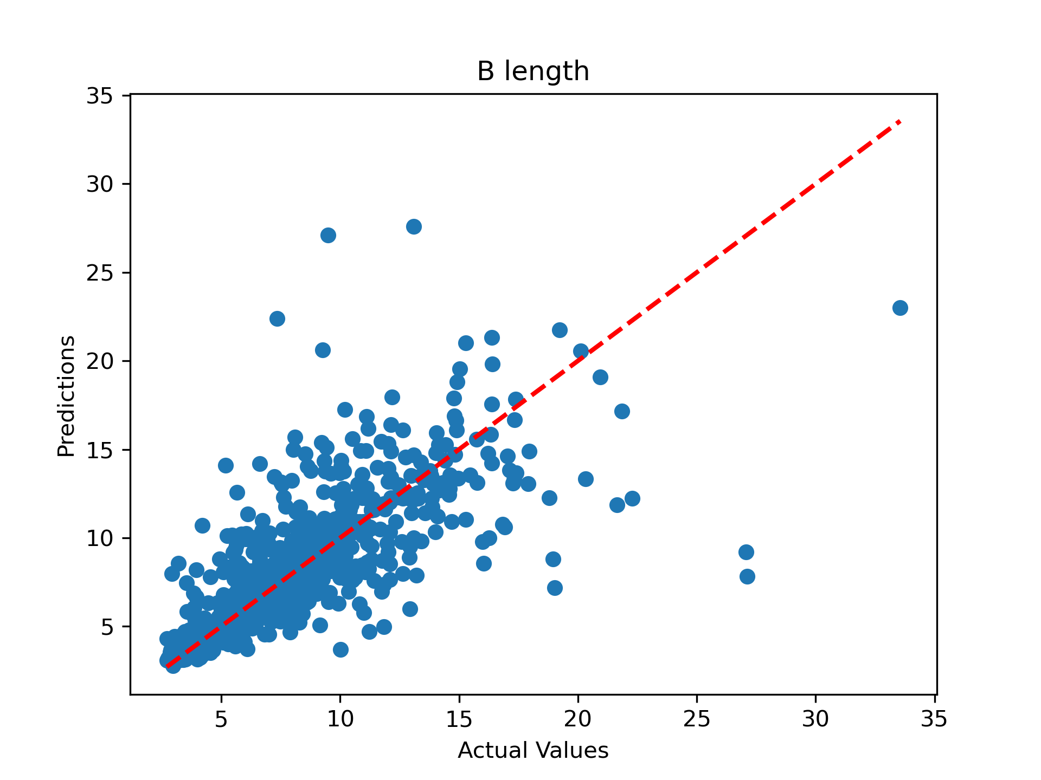
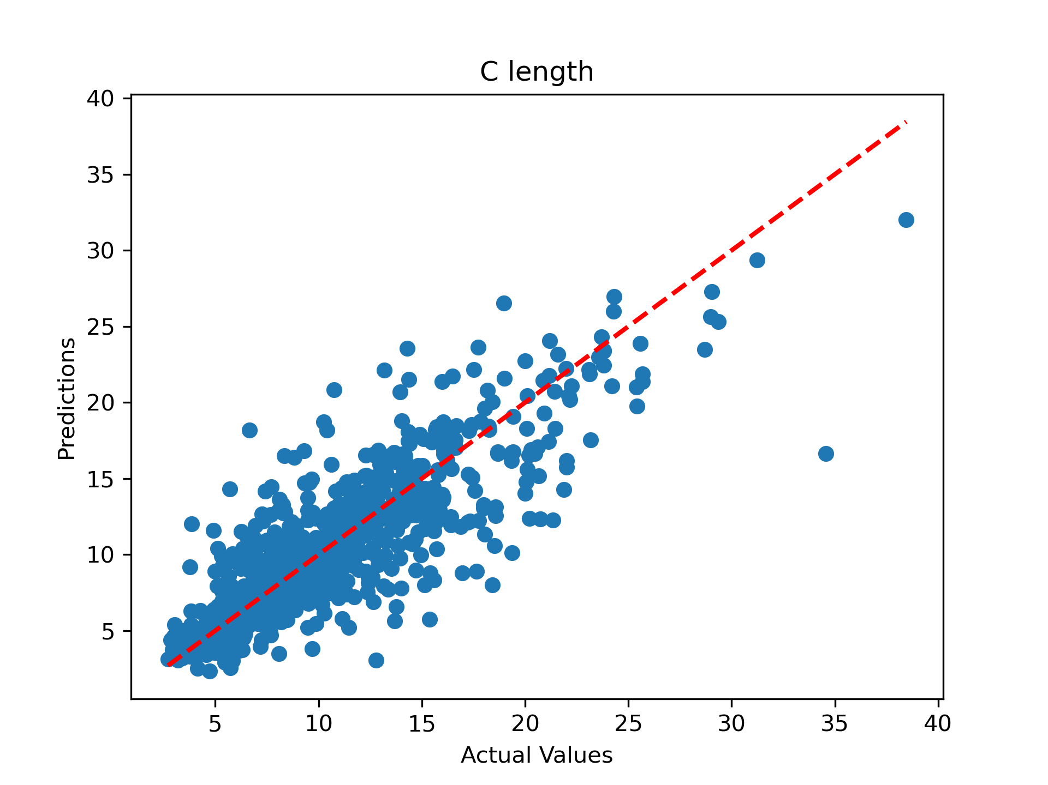
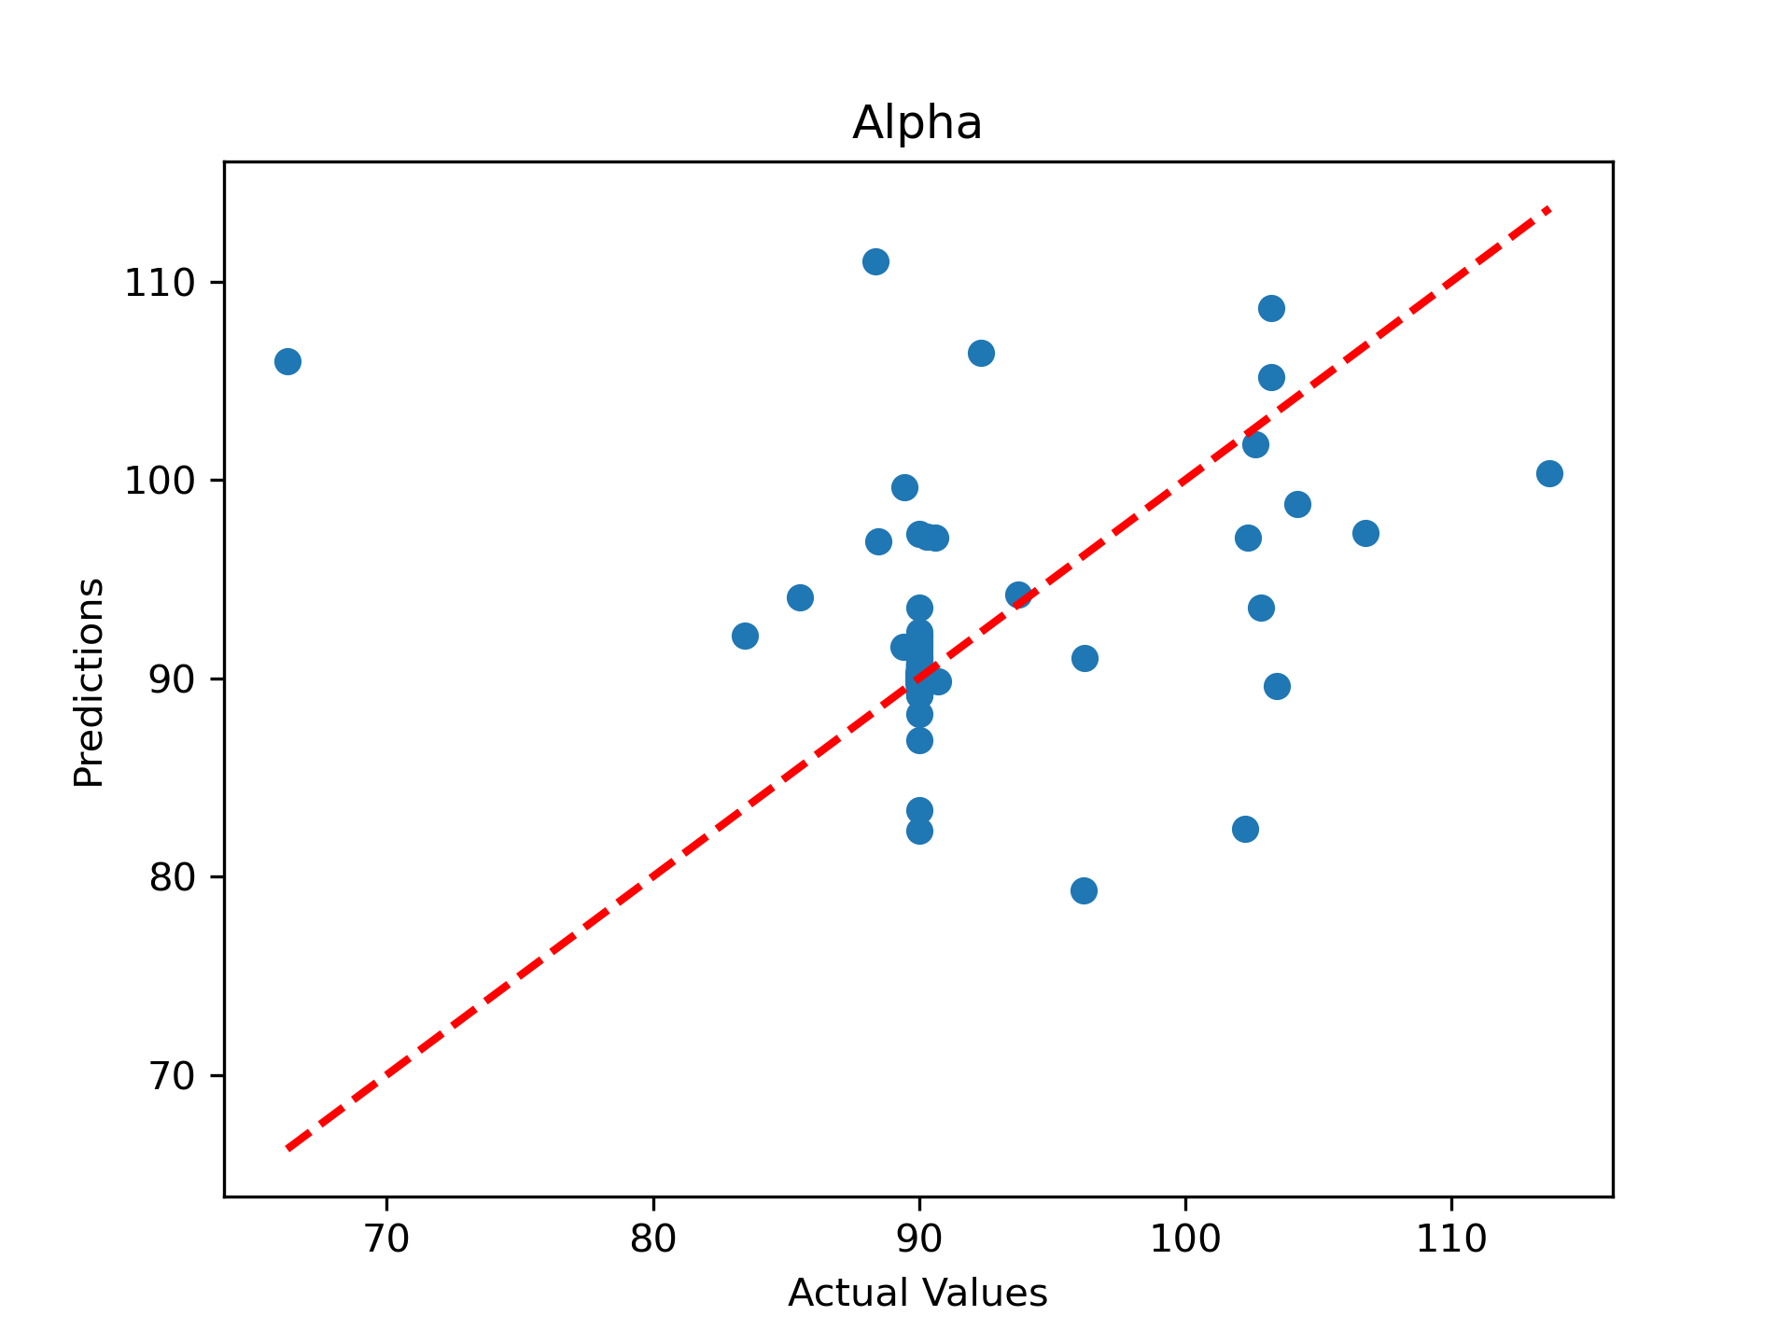
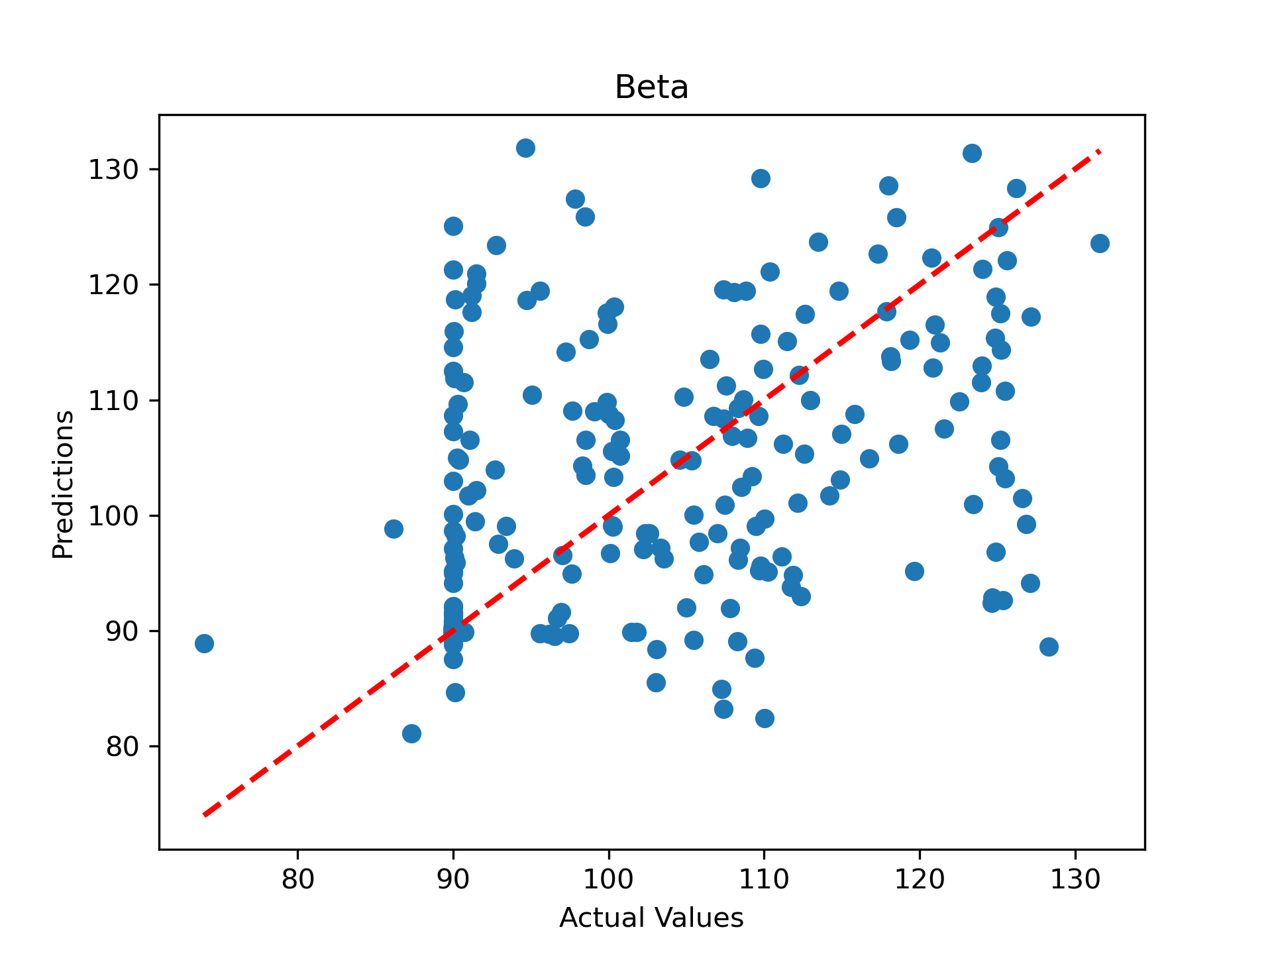
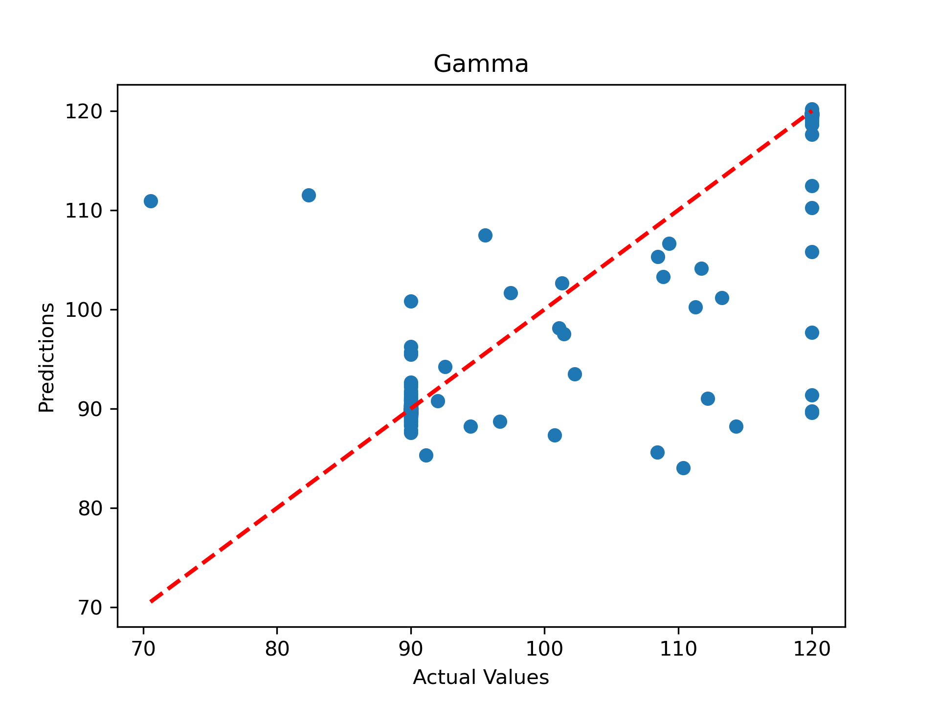
Results (Lattice Parameter)
A single regression model for all six lattice parameters.
Score Metrics:
Mean MSE: 3.18
Mean MAE: 1.15
Mean R²: 0.58
Score Metrics:
Mean MSE: 5.54
Mean MAE: 1.32
Mean R²: 0.55
Score Metrics:
Mean MSE: 6.41
Mean MAE: 1.65
Mean R²: 0.74
Score Metrics:
Mean MSE: 4.21
Mean MAE: 0.41
Mean R²: -0.48
Score Metrics:
Mean MSE: 40.33
Mean MAE: 2.31
Mean R²: 0.37
Score Metrics:
Mean MSE: 10.39
Mean MAE: 0.79
Mean R²: 0.94

Slide 7
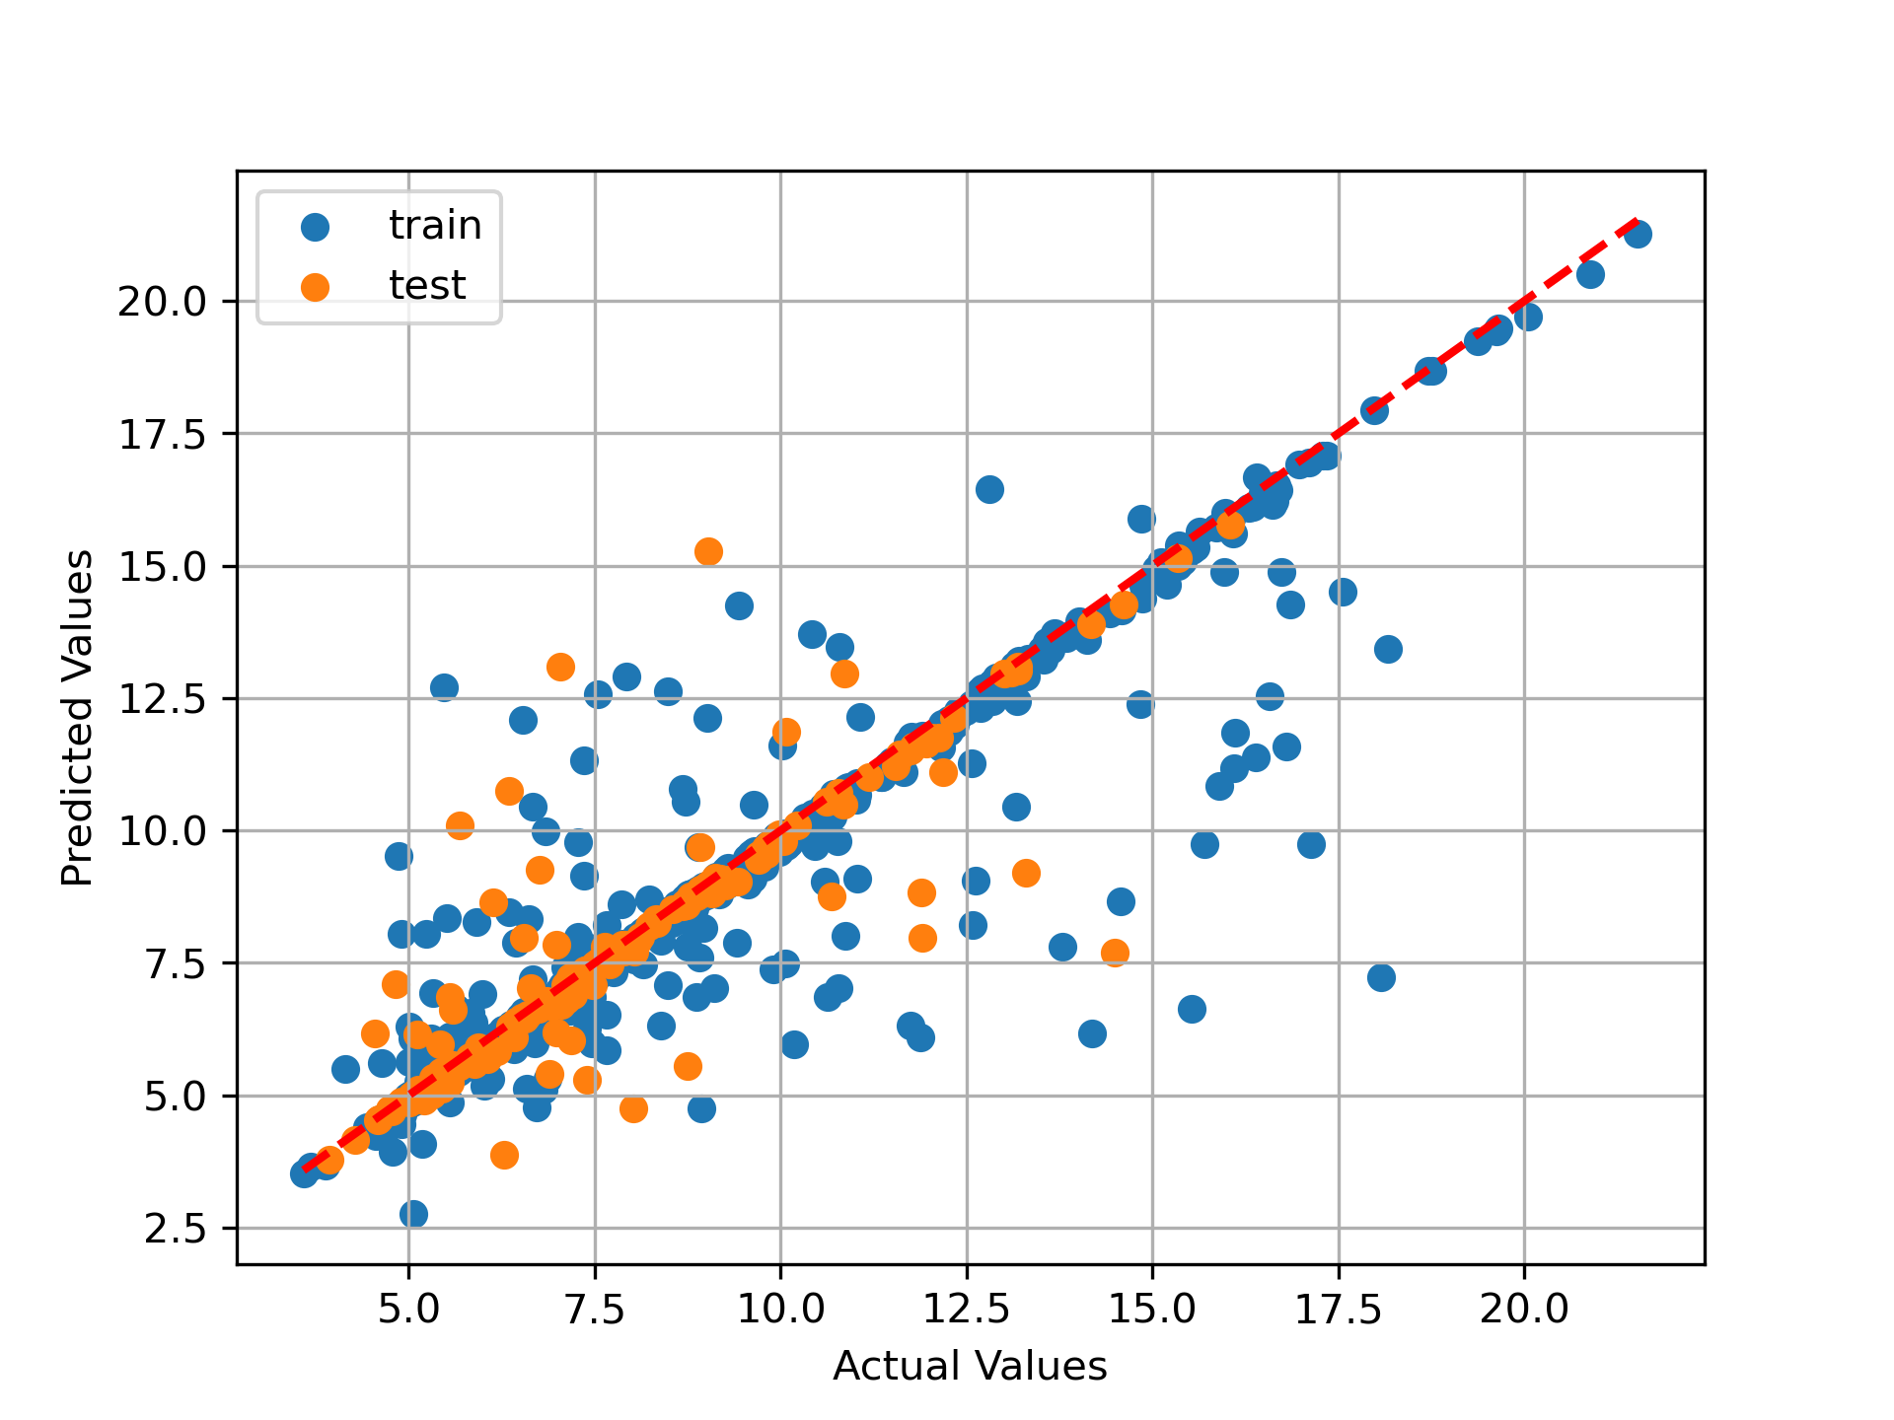
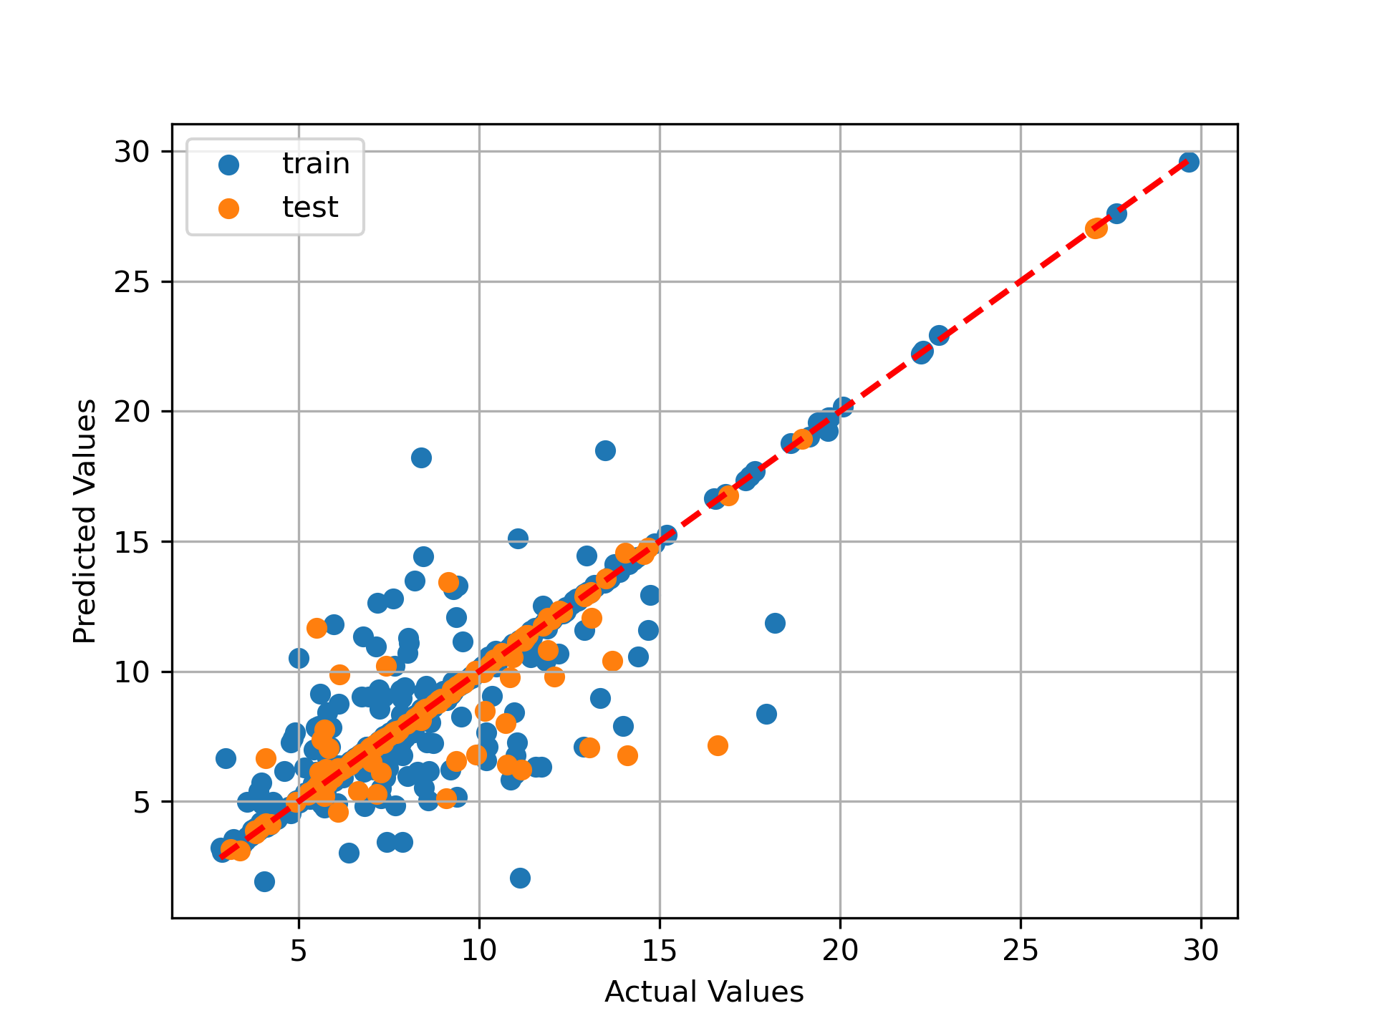
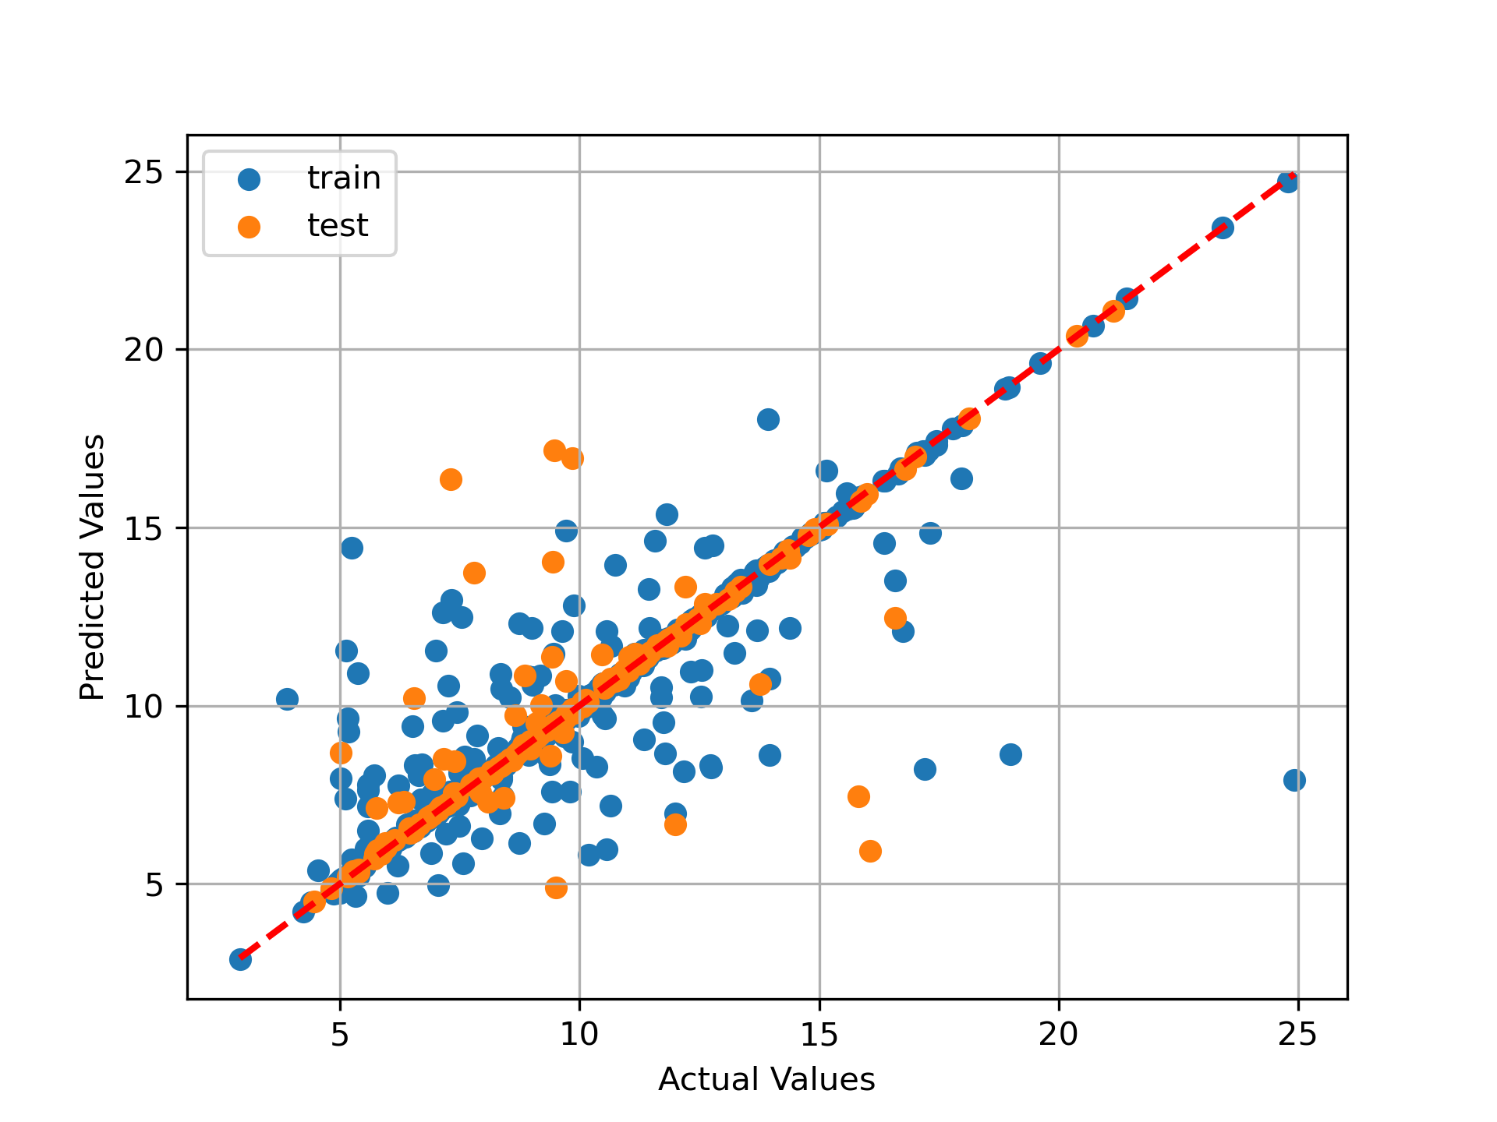
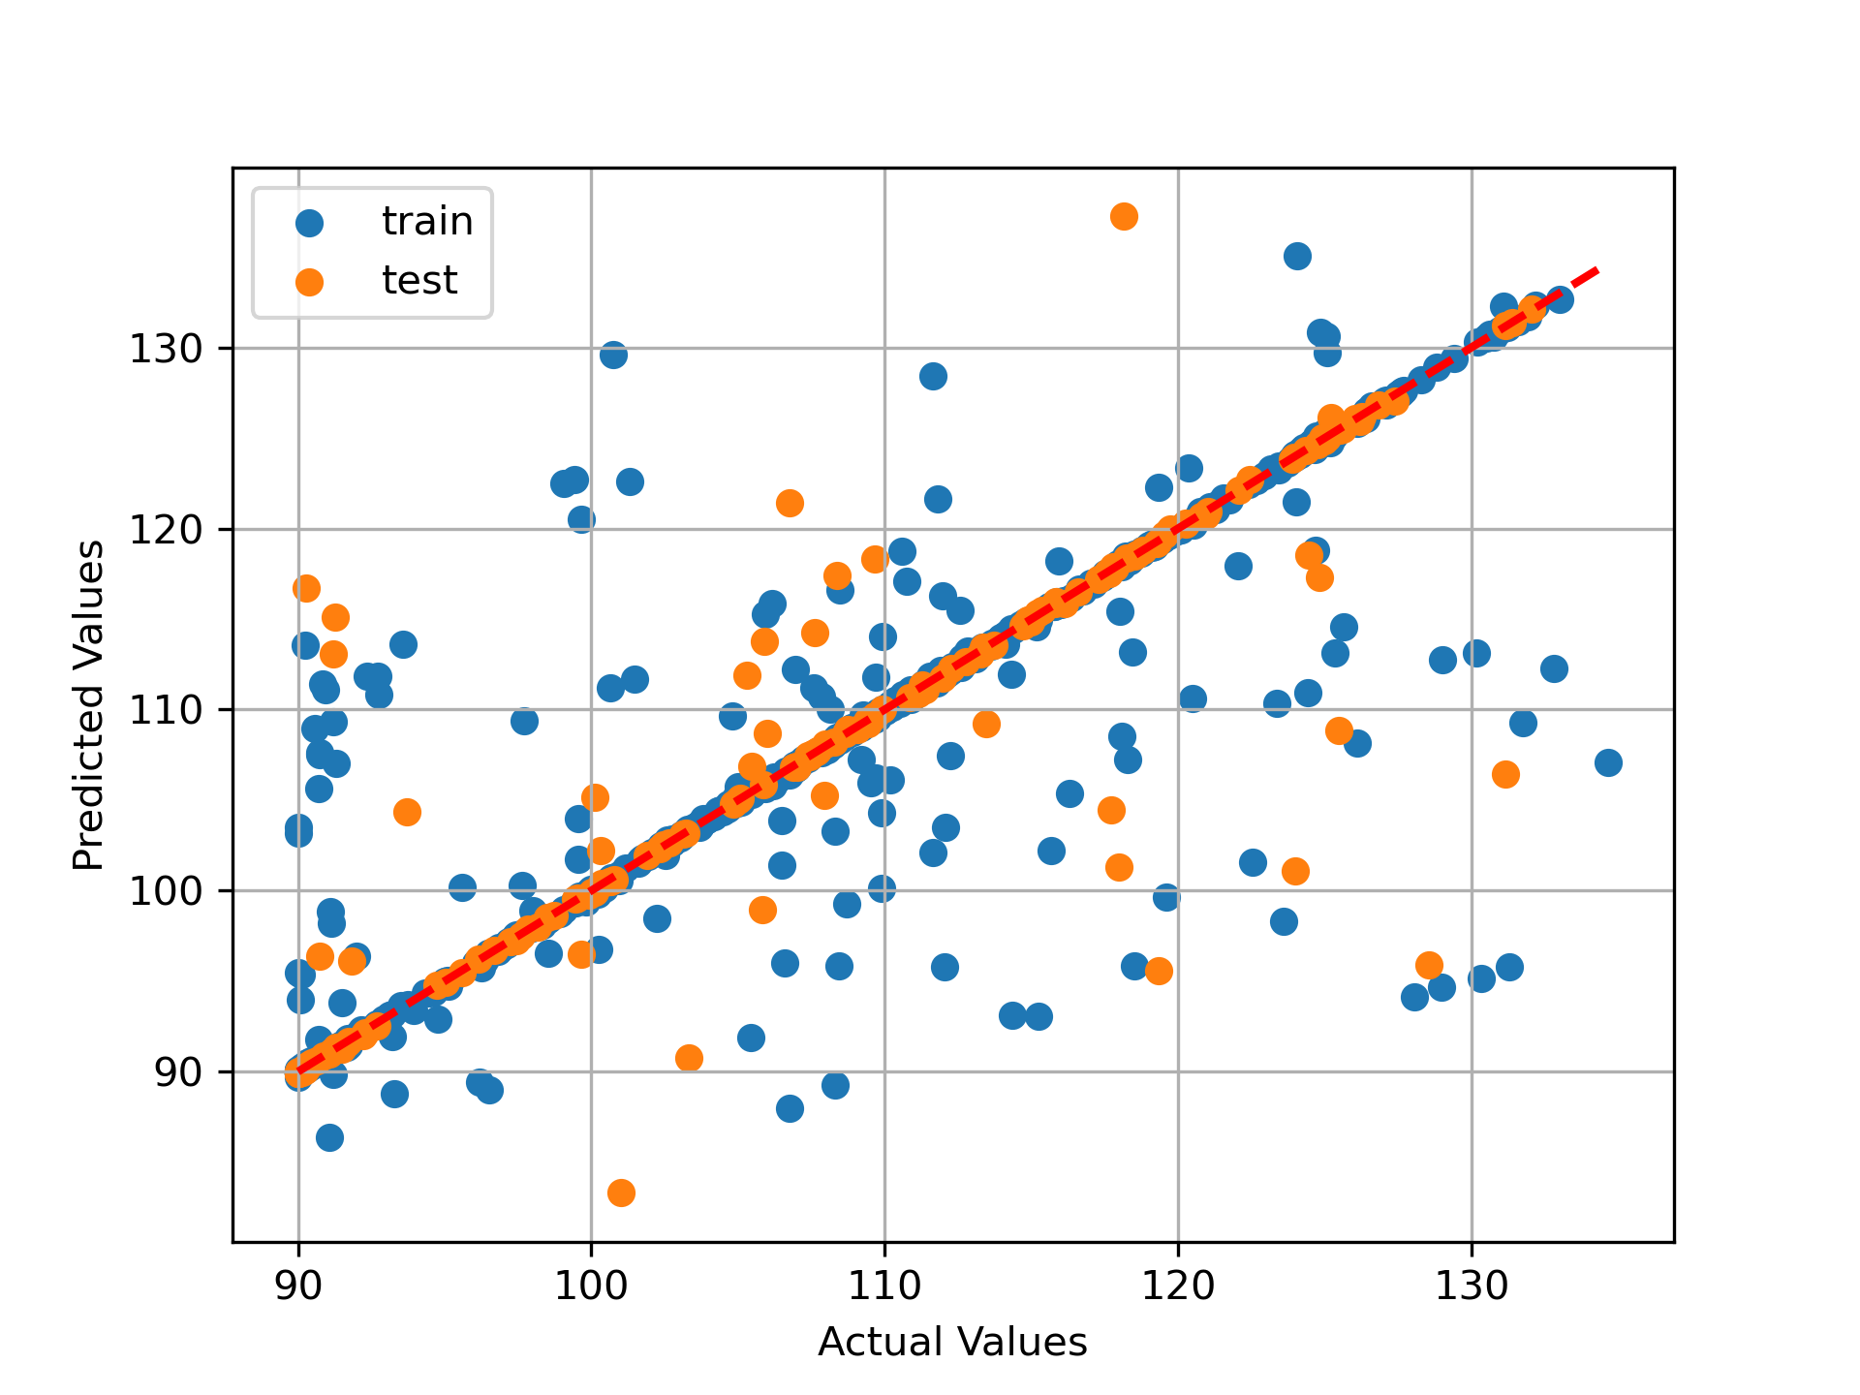
Results (Lattice Parameter)
Separate regression models based on different lattice types. (Monoclinic)
A length B length C length Beta
Score Metrics:
Mean MSE: 1.70
Mean MAE: 0.58
Mean R²: 0.74
Score Metrics:
Mean MSE: 2.35
Mean MAE: 0.58
Mean R²: 0.82
Score Metrics:
Mean MSE: 3.30
Mean MAE: 0.63
Mean R²: 0.67
Score Metrics:
Mean MSE: 42.09
Mean MAE: 2.42
Mean R²: 0.71
Notes:
I preselect all monoclinic structure in 5000 dataset use 80% for train. Since alpha and gamma are fixed for 90 degree only 4 parameters need to predict similar method I applied to all other lattice types. All generate decent result

Slide 8
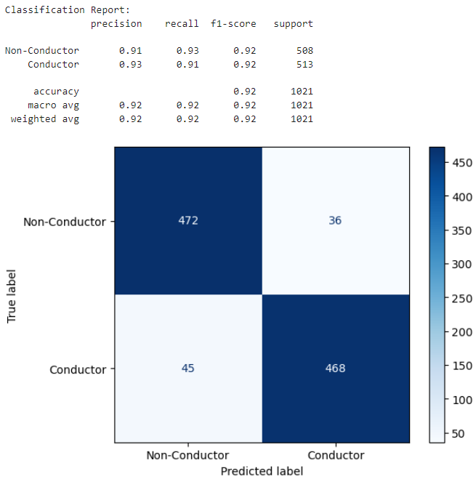
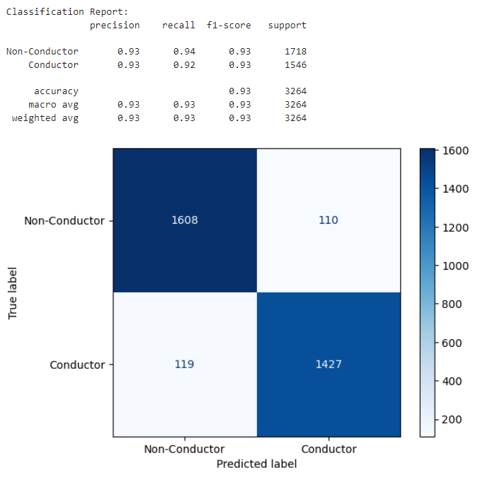
Results (Band Gap Classification)
Test set: Train set:
Hyperparameters:
Total Data Size: 5000
Learning Rate: 3e-3
Weight Decay: 8e-4
Epochs: 200
Number of Layers: 3
Embedding size: 16
Hidden Size: 32
Batch Size: 512

Slide 9
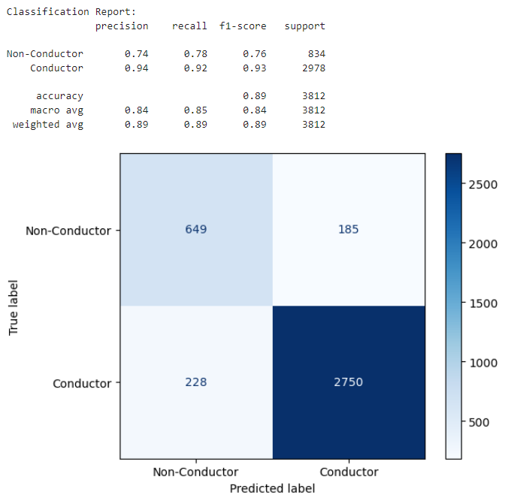

Results (Band Gap Classification)
Test set: Train set:
Hyperparameters:
Total Data Size: 20000
Learning Rate: 3e-3
Weight Decay: 8e-4
Epochs: 200
Number of Layers: 3
Embedding size: 16
Hidden Size: 32
Batch Size: 512

Slide 10
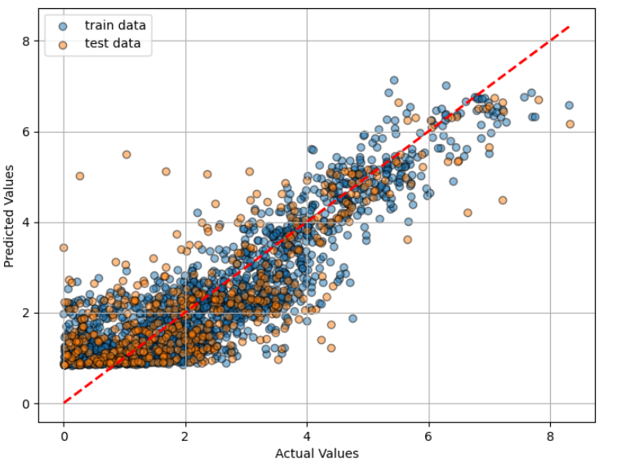
Results (Band Gap Regression)
Hyperparameters:
Total Data Size: 5000
Learning Rate: 8e-3
Weight Decay: 3e-3
Epochs: 200
Number of Layers: 3
Embedding size: 16
Hidden Size: 32
Batch Size: 512
Test Score:
Mean Squared Error (MSE): 1.2738
Mean Absolute Error (MAE): 0.8133
R² Score: 0.6331

Slide 11
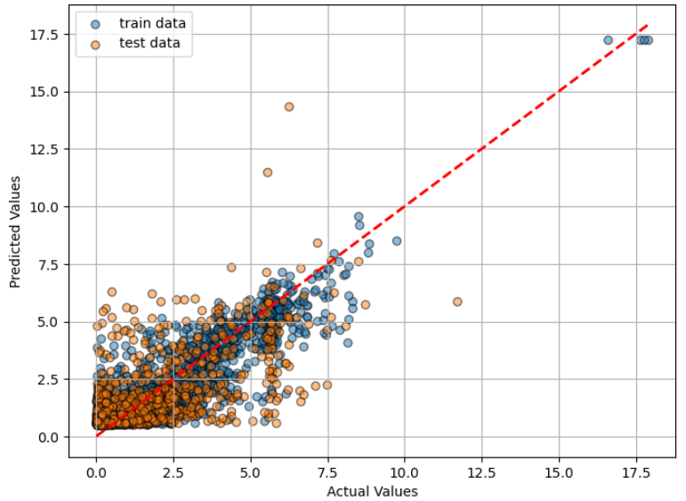
Results (Band Gap Regression)
Hyperparameters:
Total Data Size: 20000
Learning Rate: 5e-3
Weight Decay: 8e-5
Epochs: 200
Number of Layers: 3
Embedding size: 16
Hidden Size: 32
Batch Size: 512
Test Score:
Mean Squared Error (MSE): 2.4090
Mean Absolute Error (MAE): 1.0650
R² Score: 0.2745

Slide 12
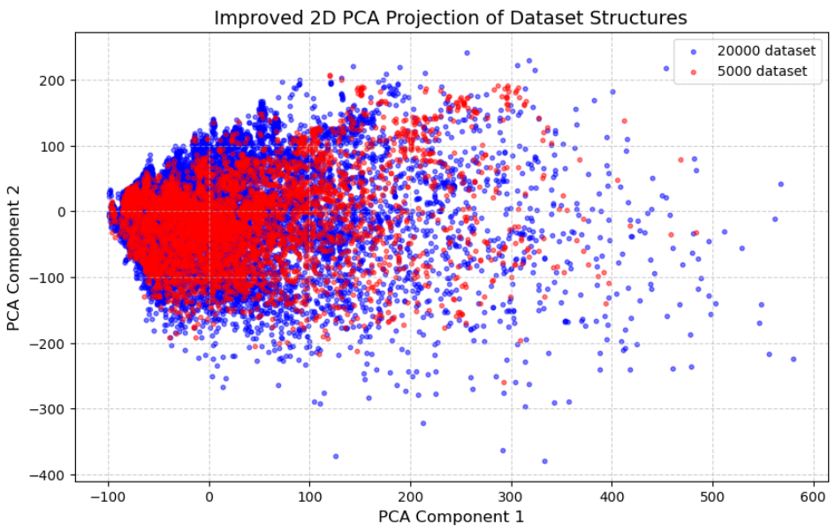
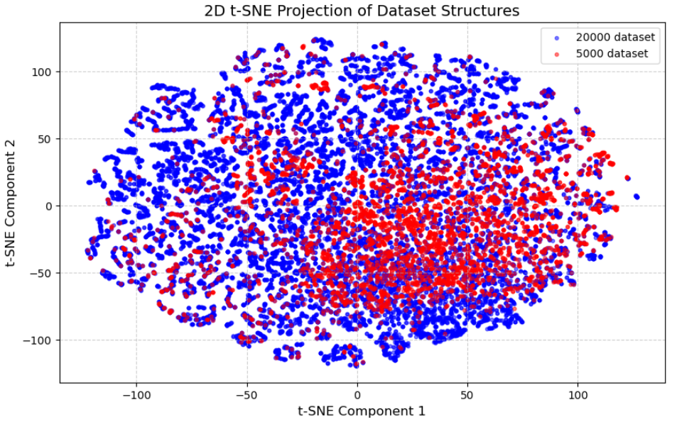
Results (Band Gap Regression)
Notes:
The PCA and t-SNE projections visualize the distribution of crystal structure datasets
The left plot (PCA) provides a linear transformation of the dataset into two principal components
the right plot (t-SNE), a non-linear dimensionality reduction technique
As the dataset size increases, it allows for a more extensive exploration of structural and property space, improving model generalization. However, a larger dataset may introduce additional complexity and noise, making predictions more challenging.

Slide 13
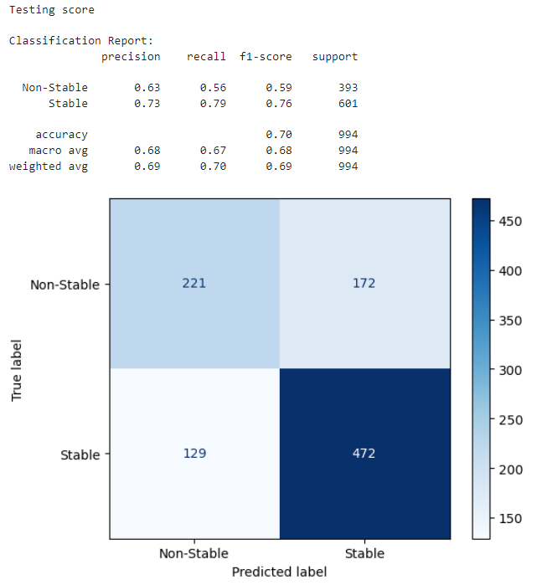
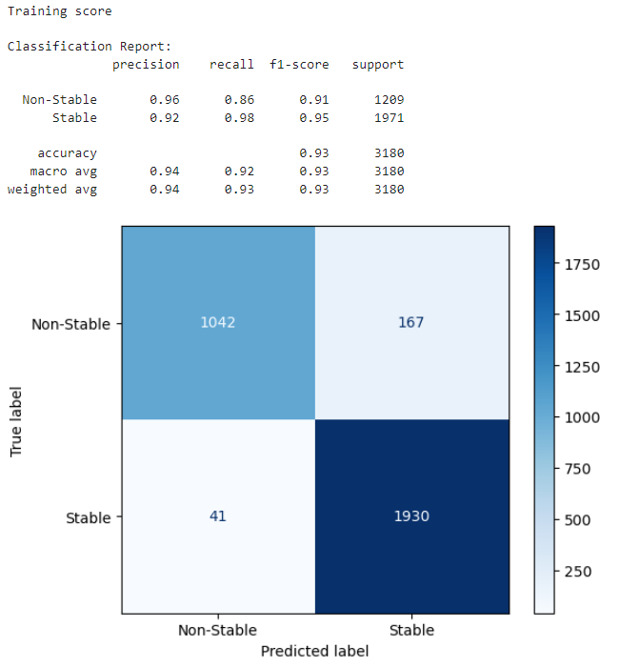
Results (Energy Above Hull Classification)
Hyperparameters:
Total Data Size: 5000
Learning Rate: 1e-3
Weight Decay: 5e-5
Epochs: 200
Number of Layers: 3
Embedding size: 16
Hidden Size: 32
Batch Size: 512

Slide 14
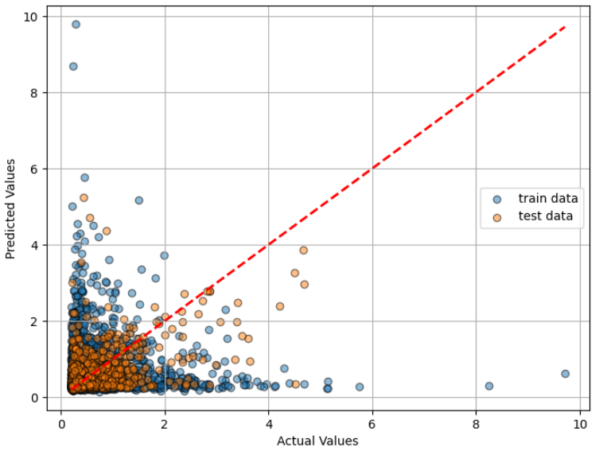
Results (Energy Above Hull Regression)
Hyperparameters:
Total Data Size: 20000
Learning Rate: 5e-3
Weight Decay: 8e-5
Epochs: 200
Number of Layers: 3
Embedding size: 16
Hidden Size: 32
Batch Size: 512
Test Score:
Mean Squared Error (MSE): 0.3130
Mean Absolute Error (MAE): 0.3024
R² Score: 0.0948
Train Score:
Mean Squared Error (MSE): 0.6642
Mean Absolute Error (MAE): 0.4481
R² Score: -0.9172

